Slide 1

American International University-Bangladesh
Learning through e-Learning in Pandemic
Official Thesis
Fall 2021-2022
Department of Computer Science

Slide 2
Submitted By:
NAME | ID | DEPT
Nafia Alam | 18-36552-1 | CS
Arindam Dey | 18-38458-2 | CSE
MD Sazzad Hossain | 18-38401-2 | CSE
Umma Khadiza | 18-38311-2 | CSE
Sajib Hasan
Assistant Professor and( External)
Department Of Computer Science
American International University -Bangladesh
Supervised By:
M.Mahmudul Hasan
Assistant Professor and( Supervisor)
Department Of Computer Science
American International University -Bangladesh

Slide 3
CONTENTS
Introduction
Previous work
Methodology
Impact on environment
Problem Statement
Solution
Conclusion
Future work
References

Slide 4
Introduction
Learning through e-Learning in Pandemic
e-Learning Background
Conceptual Framework- DSRM
Data Collection Method- Survey Analysis
Ethical issues of e-learning
Problems faced in e-Learning
Solution to the problems based on survey results
Impact of e-Learning on Environment

Slide 5
Previous work
The COVID-19 has ended in faculties close all throughout the world. Globally, over 1.2 billion youngsters are out of the classroom.
As a result, schooling has modified dramatically, where in coaching is undertaken remotely and on virtual platforms.
Research shows that on-line studying has been proven to growth retention of information, and take much less time . y

Slide 6
Previous work
E-learning tools have contended a crucial role throughout this Pandemic, serving student learning during the closure and supported accordingly.
E-learning throughout the COVID-19 Pandemic, investigate factors influencing and use of e-learning as a tool teaching among higher education.
E-learning gadgets, college students want necessary hardware like laptops or phones. E-learning is turning into a crucial device for academic purposes.

Slide 7
Methodology
Define Research Problem:
The research problem is identified.
A short plan is discussed to solve the problem.
Review The Literature:
Previous studies has been highlighted here.
Impacts of e-learning on the environment are discussed.

Slide 8
Methodology
Formulation Of Survey:
Survey had been generated using Google Forms
Only university students participated in this survey
The survey questions are given below:
I've learned a lot from my experience with the e-learning system.
The e-learning system heightens my understanding of the necessities of educational procedures.
Using the e-learning system improves my learning abilities.
I am pleased with my experience with the e-learning system.
The majority of users have a favorable opinion of or appraisal of the functionality of e-learning systems.

Slide 9
Methodology
Data Collection & Data Analysis
Table 1: Numerical distribution and fundamental criteria (individual impact)
Item | Strongly agree | % | Agree | % | Neutral | % | Disagree | % | Strongly disagree | % | Mean
1 | 143 | 26.5 | 205 | 40.6 | 117 | 23.2 | 30 | 5.94 | 19 | 3.76 | 3.8
2 | 144 | 28.5 | 220 | 43.6 | 103 | 20.4 | 27 | 5.35 | 11 | 2.18 | 3.91
3 | 157 | 31.1 | 199 | 39.4 | 92 | 18.2 | 43 | 8.51 | 14 | 2.77 | 3.88
4 | 132 | 26.3 | 169 | 33.7 | 87 | 17.4 | 81 | 16.2 | 32 | 6.39 | 3.57
5 | 77 | 15.5 | 202 | 40.6 | 138 | 27.7 | 62 | 12.4 | 19 | 3.82 | 3.51

Slide 10
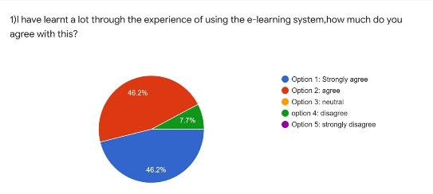
Methodology
Interpret The Result:
In this survey the using of E-learning was taken positively
The result is given below:-

Slide 11
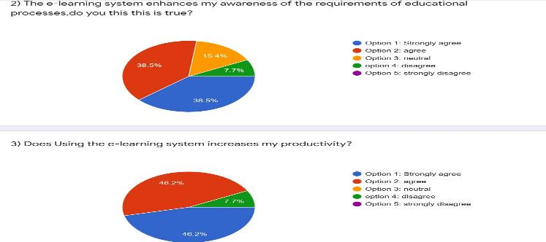
Methodology

Slide 12
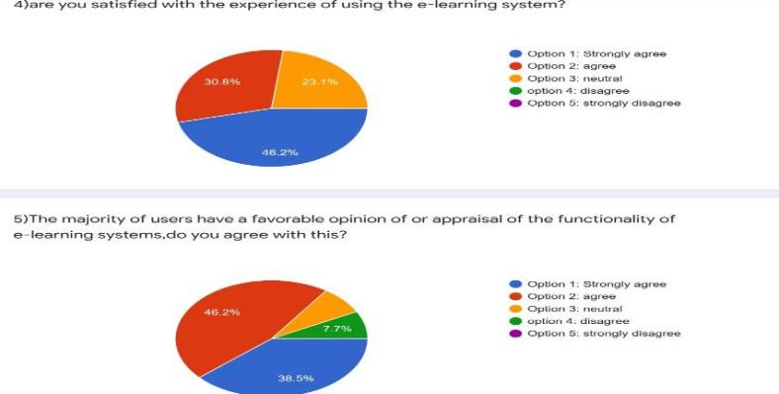
Methodology

Slide 13
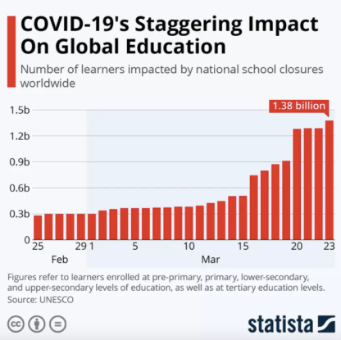
Impact on Environment
Lockdown due to COVID-19 severely impacted around 80% of the world student population
Currently desired worldwide due to its various advantages
The education industry has switched to e-learning through multiple apps

Slide 14
Impact on Environment
Apps increased their capacity for academic institutions
E-learning is yet to become the enormous scope strategy for preparing academic teachers
E-learning is considered more flexible
E- learning had a significant presence in the academic industry even before this pandemic
Technology has changed and become more advanced

Slide 15

Problem Statement
Gadgets shortage & crashing
Connectivity
Computer literacy
Lack of awareness
Motivating Learners

Slide 16

Problem Statement

Slide 17
Solution
Promote e-Learning: Getting an E-Learning program off the ground may be as simple as promoting eLearning.
Throughout the quarantine period, teachers and pupils have generally been given laptop computers to use, and there are no defined deadlines for completing work during this time .
Unfortunately, when everyone gets online, there is nothing that can be done to remedy the connection issue. In certain circumstances, calling your provider for guidance, as well as increasing your existing Internet package or hoping for 5G coverage, might be beneficial.

Slide 18
Conclusion
Tried to discuss about the effectiveness of e-learning
Main objective was to utilize the efficient way to learn through e-learning in pandemic
Researched on the challenges teachers and students face in e-learning
Provided solutions to make it more effective than before

Slide 19
Future work
Extending the study by further research
Providing alternate solutions to what already exists
Use of latest tools and resources

Slide 20
References
https://www.weforum.org/agenda/2020/04/coronavirus-education-global-covid19-online-digital-learning/
(Dhawan S. Online learning: A panacea in the time of COVID-19 crisis. J Educ Technol Syst. , 2020;).
(Basilica &Kvavadze, 2020) (Basilica &Kvavadze, 2020).

